Slide 1
OGC-Khronos ISG Sprint Demo Event: SimBlocks.io
Jordan Dauble, Owner Glen Johnson, Software

Slide 2
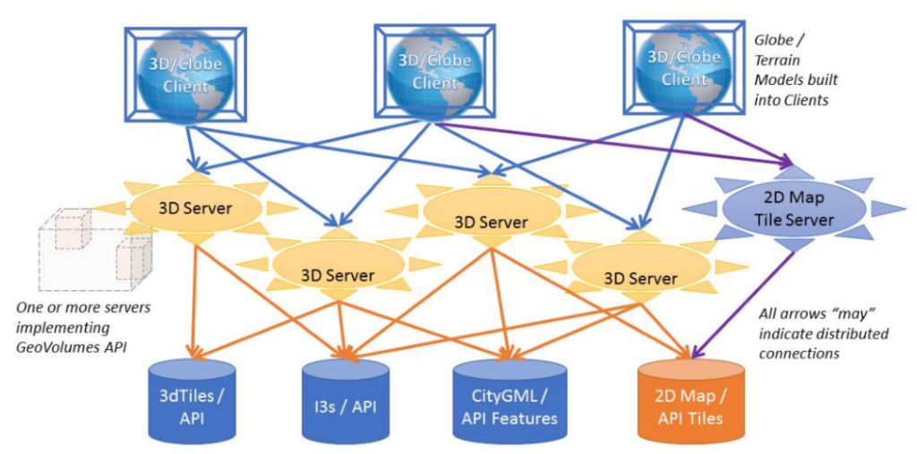
GeoVolumes Architecture

Slide 3
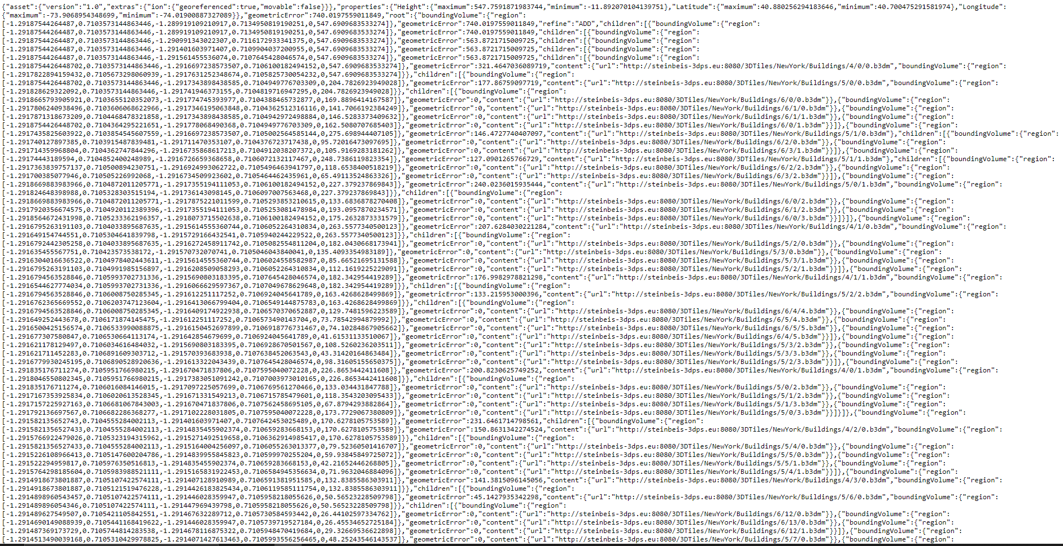
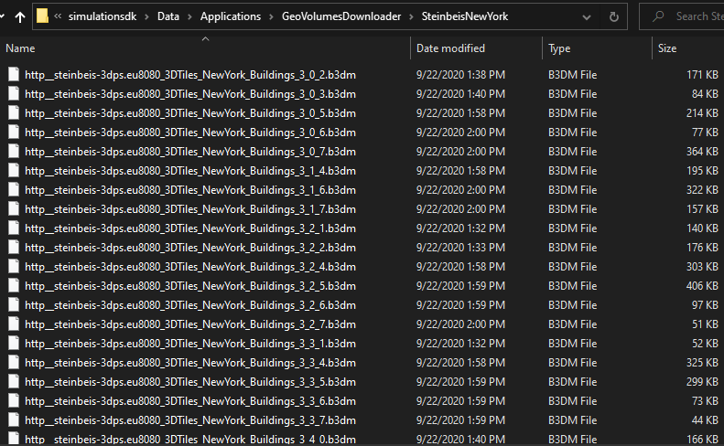
GeoVolumes Connection to Steinbeis Server
.
.

Slide 4
Conversion Methods
Method 1 - NASA Unity3DTiles Library
OpenSource library
Requires License
Method 2 - B3DM to OBJ
Convert glTF mesh buffers to OBJ files
Unity can directly load OBJ files
Method 3 - Directly load B3DM
Access glTF mesh buffers
Utilize Unity Native Rendering API

Slide 5
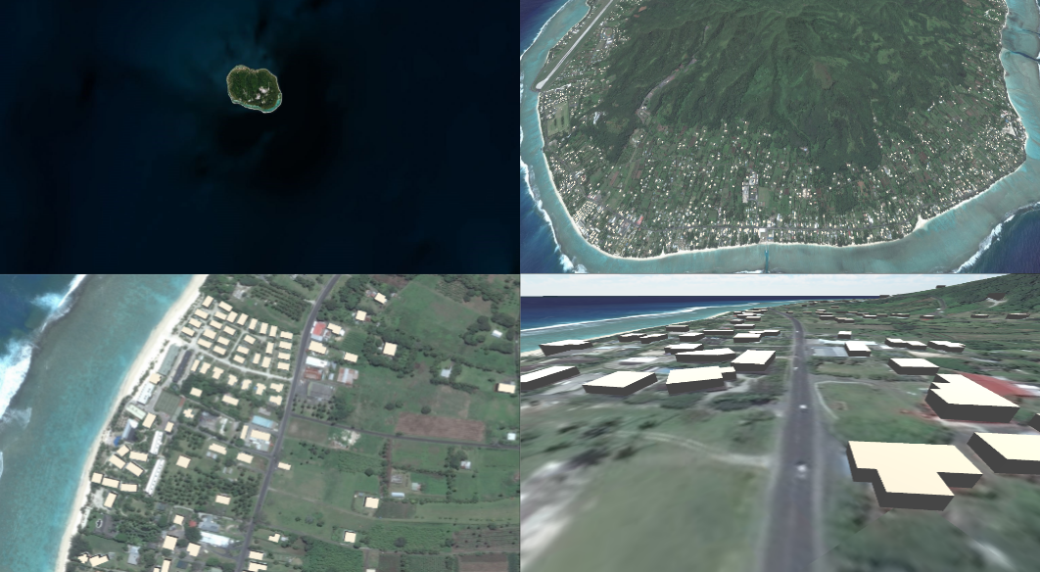
CesiumIon to Unity

Slide 6
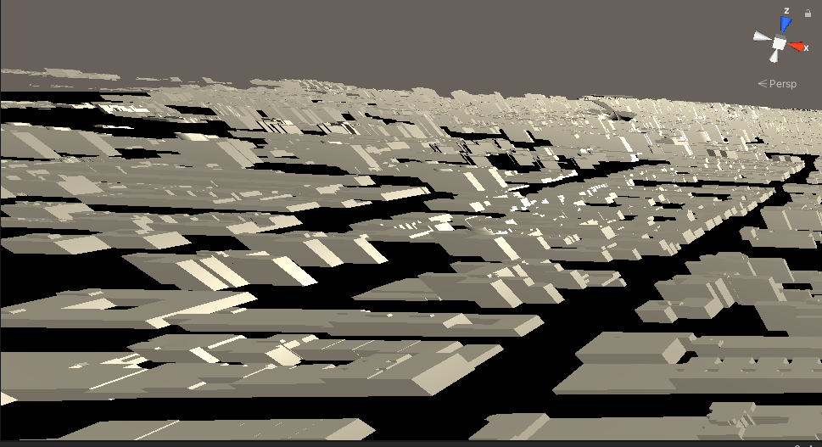
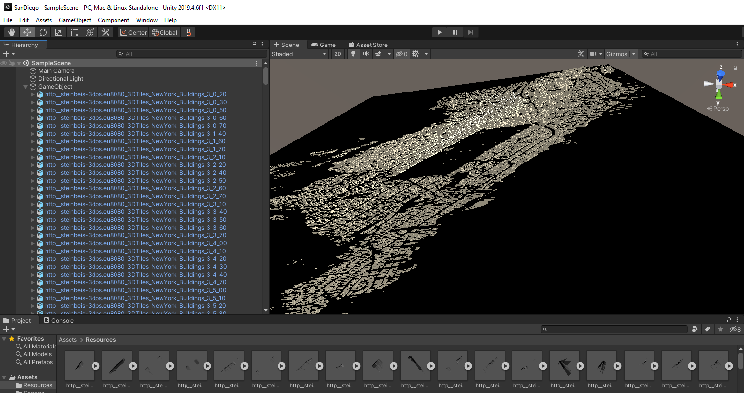
3D Tiles to OBJ Conversion
.
.

Slide 7
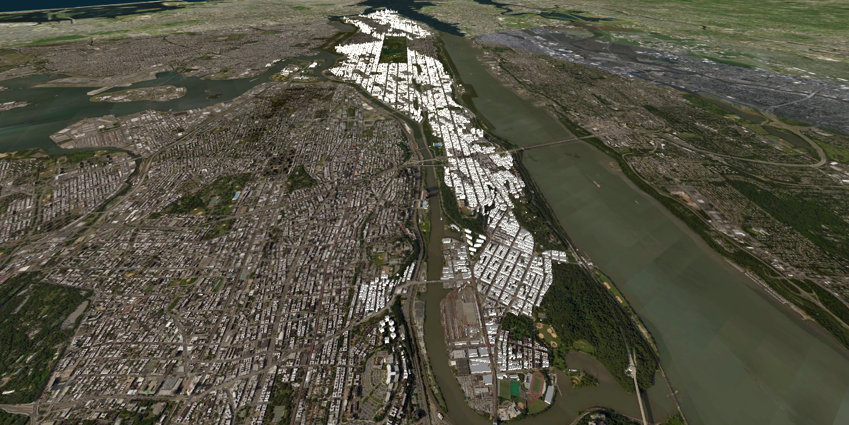
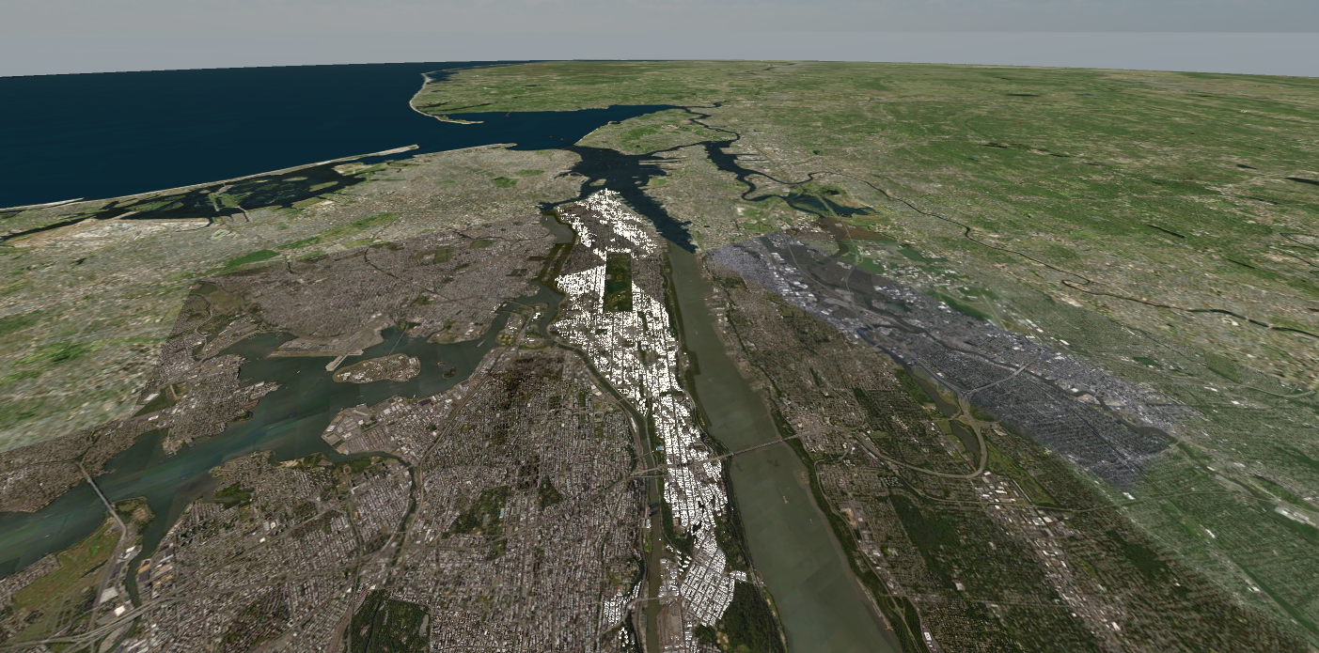
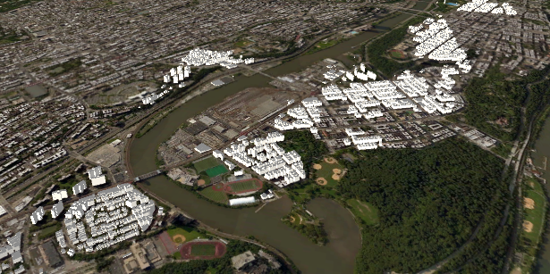
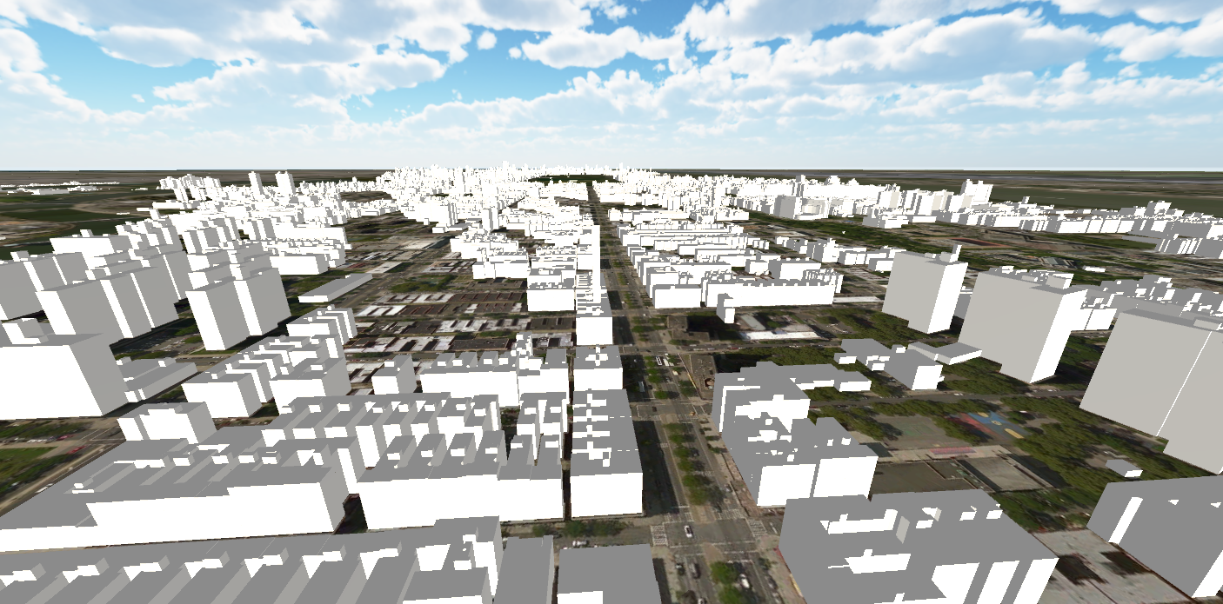
New York 3D Tiles
Connection to Steinbeis Server
SimBlocks.io Integration with Unity
One World SDK for Unity
Direct glTF mesh loading

Slide 8
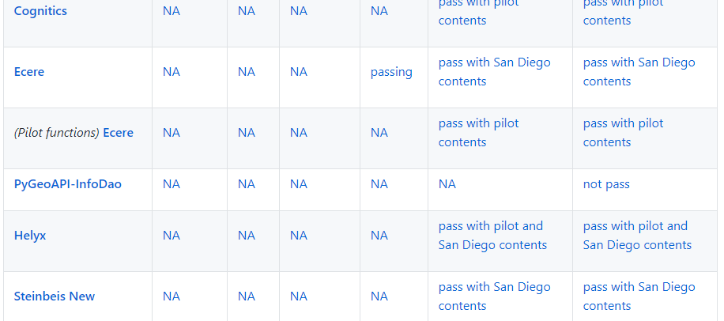
Interface Testing

Slide 9
Unfinished Work
GeoVolumes Bounding Volumes Queries
Runtime Conversion Performance Improvements
Terrain clamping

Slide 10
